Slide 1


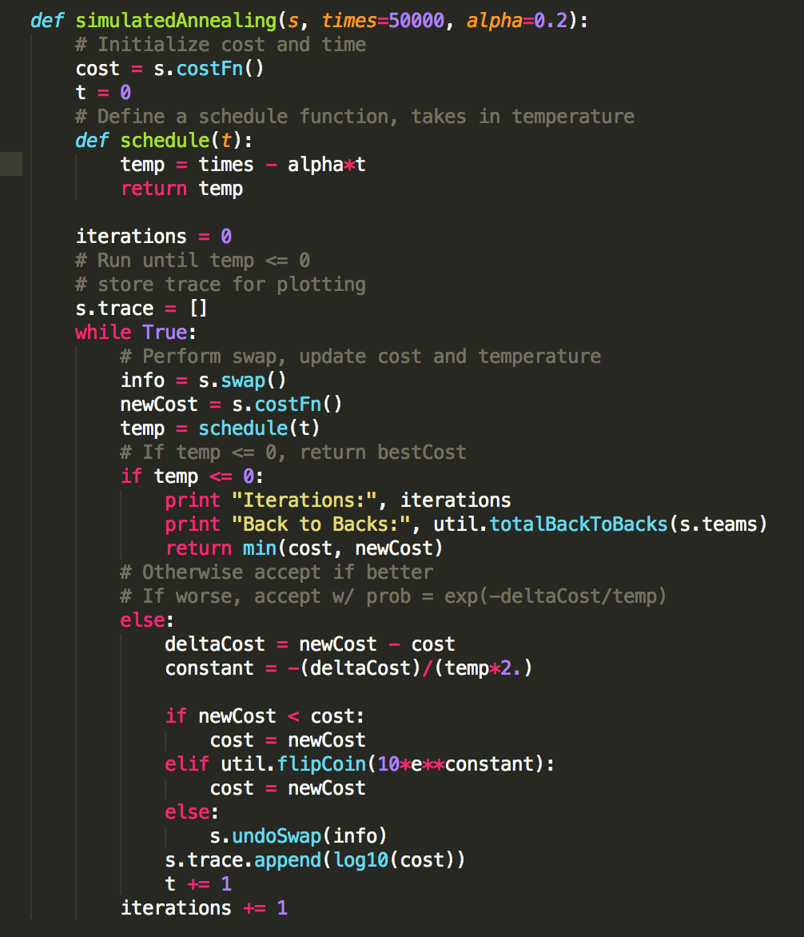
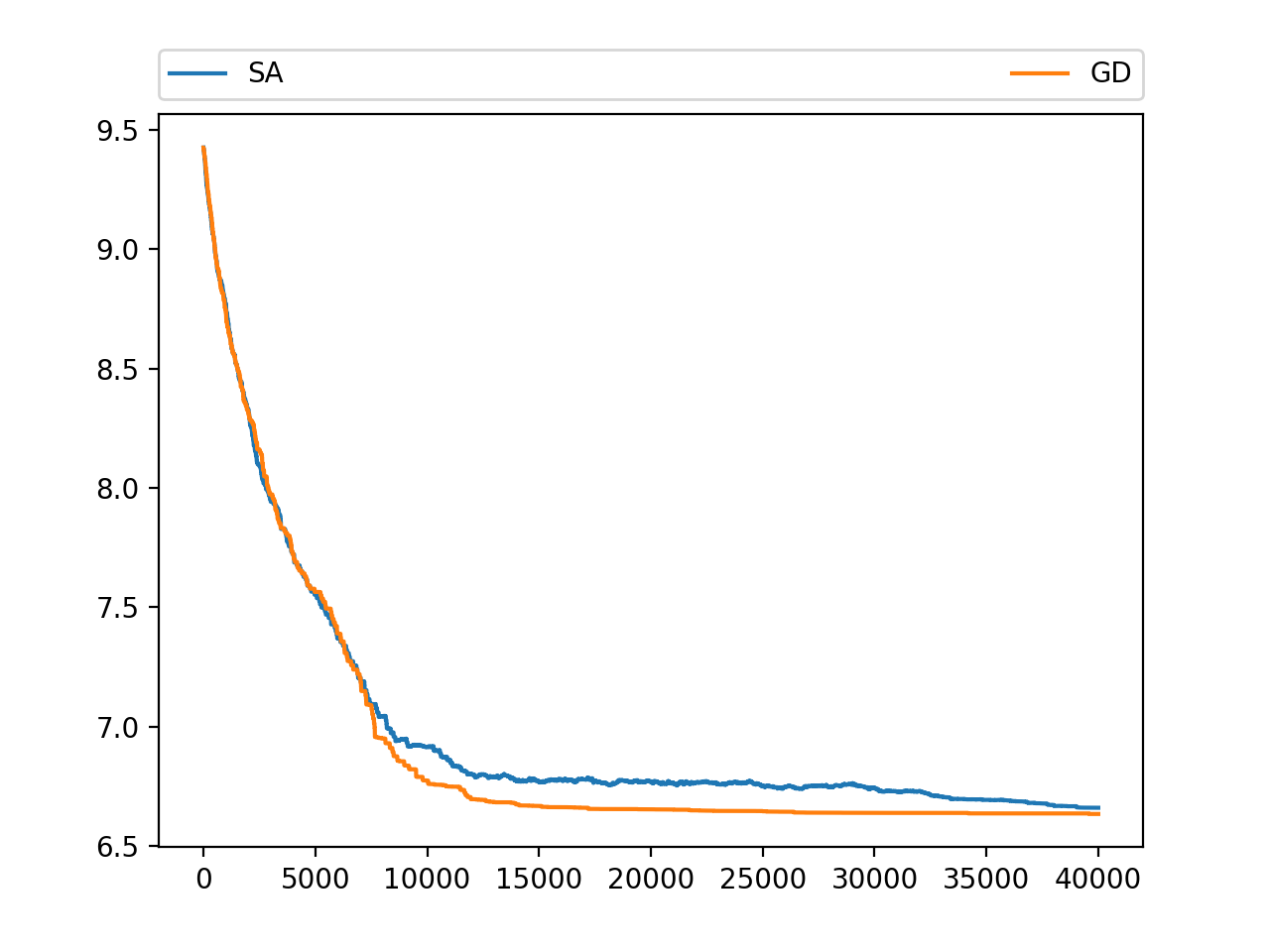
NBA Schedule Optimization as a CSP
Jack Connolly, Marty Heavey
jconnolly@college.harvard.edu, mheavey@college.harvard.edu
CS182
Fall 2017
Introduction
With 1230 games played during the course of a season, creating a fair and viable schedule for the National Basketball Association (NBA) is not a trivial matter. While this task has been carried out by hand for the last 30 years, we look to reduce travel demands and back to backs imposed by the schedule using local search algorithms. In our work, we have implemented gradient descent and simulated annealing local search in order to optimize the full season schedule. Our methods are able to overall decrease the number of back to backs played when compared to the actual NBA schedule.
Every year the National Basketball Association creates a unique schedule that includes 82 games for each of the 30 teams and fulfills a variety of constraints they require in the schedule.
Here are the hard constraints for the NBA schedule (for each team):
41 home games
41 away games
4 games against teams in their division
4 games against 6 other conference opponents
3 games against the remaining 4 conference opponents
2 games against non-conference opponents
The goal of this project was to formulate the NBA schedule as a constraint satisfaction problem, come up with a way to generate valid schedules, and optimize the NBA schedule to limit travel distance and back-to-back games.
blah blah blah
Data
Describe the data, experiments etc
Conclusions
blah blah blah
Approach
Results
We began with the 2016-2017 NBA schedule. We gathered the dates games were played during this season and based our model around optimizing a valid schedule using the same 161 dates. After formulating Python classes for teams and schedules, we created a function which generated random valid schedules. Next, we performed gradient descent and simulated annealing to minimize a cost function which took into account the number of back-to-back games of each team and the total travel distance of each team.
blah blah blah
blah blah blah
Screen Shot 2017-12-03 at 10.58.50 PM
Citations and Links
Protopapas, P. P., and friends. 2013. How we taught AM207 and lived to tell the tale. IACS Journal 1:1–3.
The students of AM207. 2013. Everything we know, we learned in AM207. IACS Journal 1:3–5.
Figure 2. Results for 40,000 iterations of greedy gradient descent and simulated annealing. The y-axis is log10(cost).
Figure 1. A version of our simulated annealing function.
John A. Paulson School of Engineering and Applied Sciences

